Slide 2
Background
January 2003 - Joint Council Retreat
Officers came up with 10 “shared principles”
Spring 2003 - Council Presidents began researching other campuses, creating vision
Fall 2003 - Call for Standards Committee members
Spring 2004 - Committee wrapped and introduced program
Fall 2004 - Program implemented
June 2005 - Program was reviewed and edited by a group of alumni/ae and undergraduate members
October 2010 - Program was reviewed and edited by a group of students for a final version that is in effect today
July 2017- Program was reviewed and updated following the 2015 Fraternity and Sorority Life External Review

Slide 3
Mission Statement
There is a common set of principles to which all Greeks ascribe. The Standards Program at NC State aims to challenge the Greek Community membership to live up to those highest principles and ideals upon which our respective organizations were founded. Knowing that individual members’ and chapters’ actions reflect on all Greeks at NC State and nationwide, our Greek community can only be as strong as its weakest link.

Slide 4
Mission Statement
The Standards Program will challenge the NC State Greeks to have integrity – steadfast adherence to the oath we took as we made a lifelong commitment to our respective fraternity/sorority. By providing a set of standards that reflect these common principles, the Standards Program provides Greeks at NC State a level of accountability, with an opportunity to seek distinction. In the end, the goal of the Standards Program is simple. As members of fraternities and sororities, we should be better for our affiliation, the campus improved for our involvement, and the greater community enhanced for our contribution.

Slide 5
The Standards Program 2023...
Academic Achievement
Alumni & Graduate Chapter Engagement
Campus Leadership and Involvement
Council Involvement
Educational Programming
Financial Stewardship
Leadership Development
Membership Development
Outreach and Civic Engagement
Responsibility, Health & Safety
Standards
Program

Slide 6
Academics Achievement
Each chapter shall have and submit a
Academic Chair
Academic Advisor
Academic Support Program
New Members
Suggested minimum GPA for bid: 3.5 high school or 2.5 college and must be full-time/degree seeking
New Member class should meet same sex average. Minimum acceptable is 0.1 below that average.
Chapter GPA
Sororities should exceed all women’s average
Fraternities should exceed all men’s average
Or
Show improvement from previous semester of .05 for conditional

Slide 7
II. Alumni & Graduate Chapter Engagement
Identify chapter advisor and submit advisor roster update form
Submit an Alumni Engagement Plan
Complete a chapter Alumni Advisor Assessment
Annually communicate with (electronic or paper)
Or
Annually co-sponsor an event with Raleigh Graduate/alumni chapter
Or
Annually host one program involving alumni or graduate members

Slide 8
III. Campus Leadership & Involvement
200% of the chapter must cumulatively attend a four all-campus event each semester; Events must represent one of each of the following four areas: Campus Pride and Traditions, Career and Academic Enhancement, Campus Life, and Diversity and Inclusion
75% must participate in one organization outside of their Greek-letter organization
The chapter are encouraged to have a faculty/staff advisor
For awards purposes only, non-educational programs open to the campus can be recorded here

Slide 9
IV. Council Involvement
Be recognized by a governing council and maintain good standing (as defined by that council)
Have 200% attend a minimum of four events, one with each council and/or chapter from each council (Events involving alcohol or recruitment/intake do not count.)

Slide 10
V. Education & Learning
Plan and implement at least 3 programs/ workshops a semester.
Programs may be hosted with 50% of the membership attending and either internal (at chapter meeting with) or open to the student body
Two Topics: Healthy Relationships, Diversity & Inclusion, Alcohol & Other Drugs, Mental Health, Values Alignment, or Accountability
Programs may be attended with no minimum
All members are required to complete both Hazing Prevention: It’s Everyone’s Responsibility as well as the Fraternity and Sorority Life module-Everyone complete by Oct 1st

Slide 11
Prevent Zone
hazing.ncsu.edu

Slide 12
V. Education & Learning
85% of the chapter must attend their assigned EPIC program(Encouraging Positive Interventions within Chapters) program annually. EPIC Programs associate with the following topics: sexual assault prevention, diversity and inclusion, alcohol and other drugs. Chapters must rotate through topics once per year, completing all three programs by the third year.
Chapters are encouraged to provide training for members covering: healthy relationships, trauma informed survivor support, and/or an overview of important terminology and procedures regarding Title IX.

Slide 13
VI. Financial Stewardship
Maintain good financial standing with your respective council, the university, and housing agencies, if applicable.
Document that the chapter has prepared a budget, has presented it to the general body, and that the said budget has been approved by the chapter advisor by September 15th each year. A written analysis of chapter finances is due May 31st
Or
Chapters seeking assistance with budget development/ chapter finance matters may submit an actual budget proposal, mid-year report, and final report for feedback.

Slide 14
VII. Leadership Development
Leadership Development within your organization
Officer Transitions – plan a retreat/meeting time for newly elected officers to be properly transitioned by outgoing officers with the chapter advisor involvement.
At least one person should attend(digitally counts) a leadership program and/or business meeting sponsored by your national/regional organization
The executive board should prepare goals each semester

Slide 15
VII. Leadership Development
Leadership Development via Fraternity and Sorority Life and other Campus Resources
Chapter President must attend Greek Leaders Retreat (proxy=conditional
Chapter President should attend 70% of monthly president roundtables
Nominate members for Order of Omega

Slide 16
VIII. Membership Development
Comply with Membership Rules for Recruitment, Intake, and New Member Activities
Maintain an up to date membership roster
Intentionally create two events a semester, outside of chapter meetings, that are for members only with a majority of the membership participating.
Both formal and informal interaction is appropriate
Intramural or step teams may count as one event each semester
Parents and Family events also meet this requirement
Develop retention efforts for maintaining relevance to members throughout their lifelong affiliation.
Demonstrate an initiation rate of 85%.

Slide 17
IX. Outreach & Civic Engagement
Serve the Community.
Initiate and implement one community service project (donation of time) each semester. If co-sponsored, may satisfy council involvement additionally.
Chapter should acquire an average of 12 hours per member in volunteer hours with no less than 75% of the chapter membership participating. (Chapter will submit roster with hours and agencies by January 1st and May 31st each year) Submit documentation through HelperHelper

Slide 18
IX. Outreach & Civic Engagement
Give.
Initiate and implement on philanthropic event in which >75% of your members raise money or goods to donate.
Submit goals per member
Submit a receipt of donation (picture, check, letter)
Participate in at least one philanthropy of another organization, preferably one from each council.

Slide 19
IX. Outreach & Civic Engagement
Raise Awareness.
Raise awareness for causes. Examples may include hosting events, passing out information on campus, creating social media/digital campaigns to educate the community on important cause and how they can provide support.
Engage in Civic Action.
Assist members in finding ways to actively engage in the community through social justice initiatives, civic responsibility, or working to support community partners.

Slide 20
X. Responsibility, Health & Safety
Comply with your National Risk Management Policy.
Comply with RUL 11.56.01- Rule for NC State University Fraternities and Sororities Hosting Social Events.
Submit a copy of your national risk management policy as well as your implementation plan to the Department by September 1st each year.
All organizations are subject to the Code of Student Conduct. Probation and violations are noted.
Appropriate officers must attend a Responsibility, Health & Safety training session coordinated by Fraternity and Sorority Life each year.
<8 | 2
8-24 | 3
25-50 | 4
51-100 | 5
>100 | 6

Slide 21
X. Responsibility, Health & Safety
New members should participate in education geared toward alcohol and other drugs education
Chapters are encouraged to host programs which specifically address health and safety issues including: interpersonal violence prevention, suicide prevention, bystander intervention, fire safety, etc. (for distinction)
Chapters should encourage members to apply to serve as Certified Peer Educators for Fraternity and Sorority Life prevention efforts (for distinction)

Slide 22
Service Hours

Slide 23
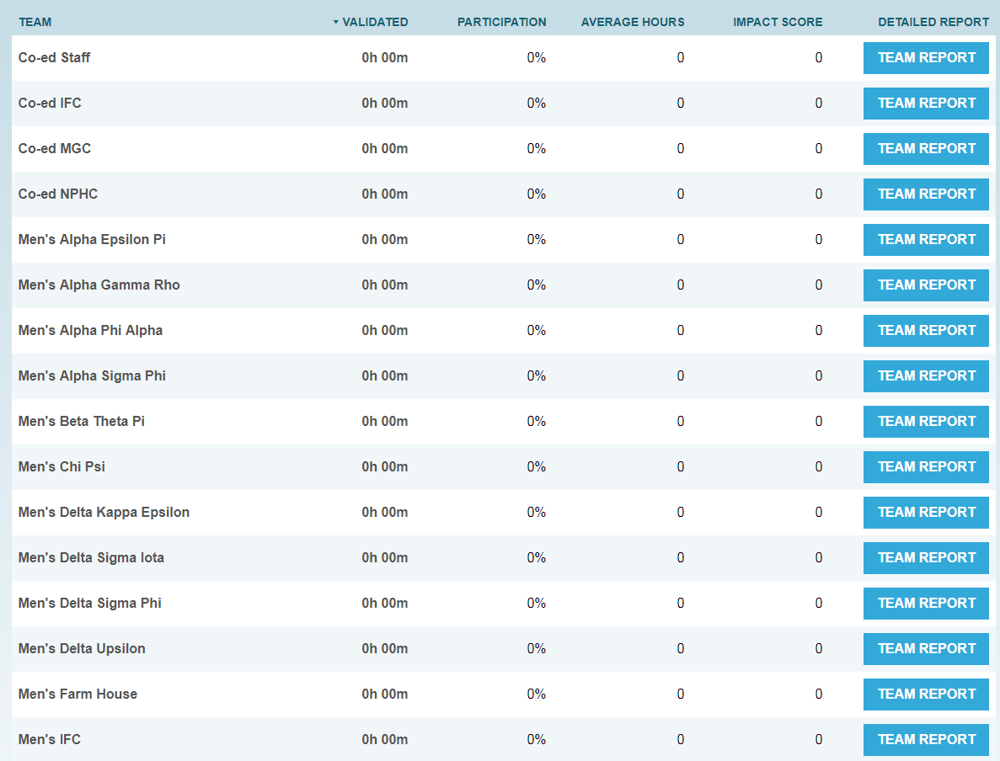
Helper Helper Reports

Slide 24
Standards Forms

Slide 25
EOY Standards Review Meetings
We will have 2 meetings this year. One will take place at the end of the 1st semester (Nov, early Dec.)
Second and final meeting will take place in May.
Your chapter will receive your meeting time by Oct (Fall) and April (Spring)
Chapter Presidents and Standards Chairs will be invited to these meetings
Important to have someone attend that is knowledgeable about the information submitted

Slide 26
Accountability
Chapters - annual report with details of their results
Overall Results will be shared with public at large (Y, N, or C)
Detailed results shared with chapter, chapter advisors, HQ/ regional/consultant staff
Results provide a framework for Staff to assist officers with chapter development
Results compiled to create positive PR for the community
Councils may create consequence to chapters who fail to meet standards, but the Department will not.
Department requires participation as a condition of recognition (55% compliance or higher)

Slide 27
Distinction
Eliminated need applications for awards (individual awards will still need applications)
Councils may use the standards as a basis for council awards
Department will recognize annually, the chapters who meet/exceed standards. Awards will be given to the top chapter in each “shared principle”
Annual awards are given the week of Homecoming each year to allow the summer months to evaluate submissions

Slide 28
Strategies for Success
One person for the academic year
Document as you go – this is not an end of the year program!
Meet with Fraternity and Sorority Life once a semester or once a month to review progress and ensure your work counts
Be detailed – awards aren’t given for one word descriptions
Collect information from your members on a weekly basis for events they have participated in

